Slide 1

BRITISH AIRWAYS
Customer Rating Analysis And Insights

Slide 2
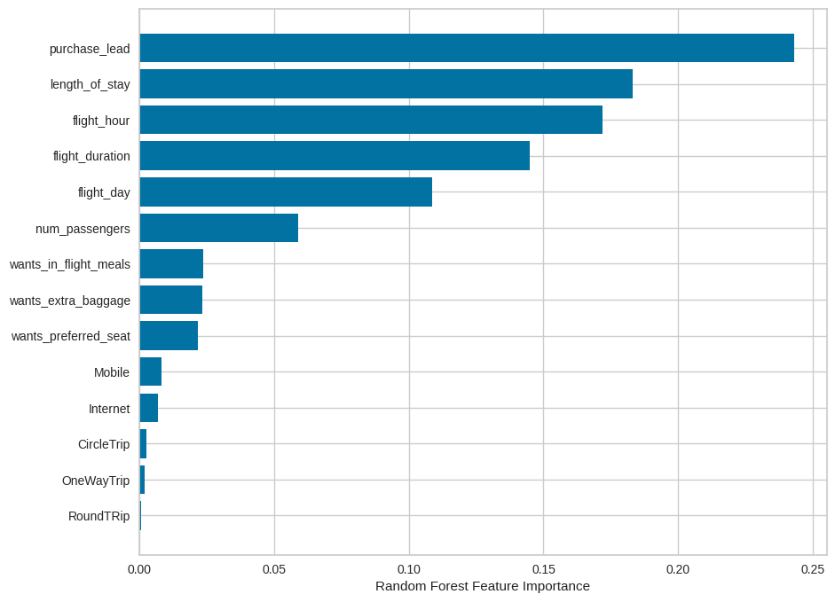
Predictive Modelling Results
Recall Rate
52%
Precision
62%
Chance of predicting true successful bookings.
63% Chance of predicting true incomplete bookings correctly.
Accuracy
63%
The accuracy of the model predicting successful or incomplete booking is:
We are concerned with not predicting the successful bookings correctly. The imbalance dataset drives higher accuracy, but it does not accurately predict the successful bookings.
Out of 50000 booking entries, only 14.96 % of bookings were successful or complete.
Top features that can drive successful flight bookings

